Slide 1


ALTSCHOOL OF Cybersecurity (BARAKA 2025)
MONTH 2 – WEEK 5

Slide 2
REFRESHER – LAST WEEK
Overview Legal Frameworks
  Introduction to key Legislation and Regulations (GDPR, HIPAA, CCPA, etc.)
    Importance of Data Protection and Privacy Laws
    The growing need for compliance in a digital world
    Understanding Data Privacy & Security Regulation
  Compliance Requirements and Standards
  Intellectual Property and Copyright Laws
Ethical Hacking
  Introduction to Ethical Hacking

Slide 3
Month 2 - WEEK 5 (Day 1)
Risk Management
  Overview of Identifying Risk and Type of Risk
  Risk Identification Techniques
  Accessing Risk and Prioritizing Risk
  Mitigating Risk Monitoring and Communicating in Risk Management
  Risk Management Frameworks – Overview
  Importance of Risk Management Frameworks and Primary Components of RMFs
  Top Risk Management Frameworks Today.
  Benefits of Risk Management Frameworks and Framing your Risks
Introducing Key Legislations and Regulations, Compliance Requirements and Standards
  Introduction to Key legislations and Regulations (GDPR, HIPAA, NDPA, CCPA, etc)
  Compliance Requirements and Standards
  Examples of Cybersecurity Standards (ISO 27001, PCIDSS, NIST)

Slide 4
Risk Management

Slide 5
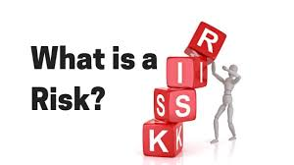
RISK
Risk can be defined as a probability of the occurrence of a threat or an event that may damage, or cause loss or have other negative impact either from internal or external liabilities.

Slide 6
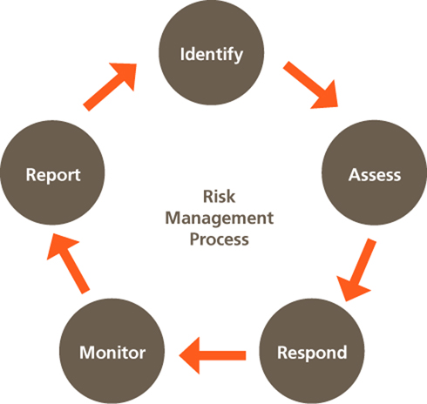
RISK MANAGEMENT
Risk management is the process of identifying, assessing, and mitigating risks that could impact an organization's objectives. It helps businesses minimize threats while maximizing opportunities.
In Cybersecurity security, risk management involves protecting systems, data, and networks from cyber threats.

Slide 7

TYPES OF RISK
Strategic Risks
These are risks that arise from an organization’s business strategy and objectives. For example, entering a new market or launching a new product may have strategic risks associated with them.

Slide 8
TYPES OF RISK
Operational Risks
These are risks that arise from an organization’s day-to-day activities and processes. Examples include technology failures, employee errors or supply chain disruptions.

Slide 9
TYPES OF RISK
Financial Risks
These are risks that arise from an organization’s financial operations and management. Examples include credit risk, market risk and liquidity risk.

Slide 10
TYPES OF RISK
Legal/Compliance Risks
These are risks that arise from an organization’s failure to comply with laws, regulations or industry standards. Examples include contract disputes, intellectual property disputes, employment law violations, data privacy violations or noncompliance with environmental regulations..

Slide 11
TYPES OF RISK
Reputational Risks
These are risks that arise from damage to an organization’s reputation, image or brand. Examples include product recalls, lawsuits or negative media coverage.

Slide 12
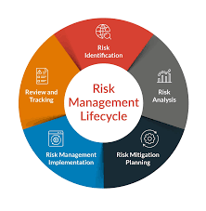
RISK Identification Techniques
Brainstorming
    This is the act of gathering team members to think about and discuss a subject and to form solutions to any identified problems. This kind of meeting allows a team to speculate on ideas, discuss facts and look at a project's future. You can use brainstorming to identify, analyze and address potential risks by hearing from people who work at the front end of the business. Team members may have a better understanding of how the business operates from the ground level and can share their own perspectives of the company's risks

Slide 13
RISK Identification Techniques
Stakeholder interviews
    Stakeholders are the people who have an interest in your project or business, and interviewing them may help you better understand what they believe are the biggest risks. Stakeholders often have invested significant resources, whether it be time, money, labor or all three, into your business. They understand risk from an outsider's perspective as an investor, not a laborer or leader.

Slide 14
RISK Identification Techniques
The NGT, or nominal group technique, is another method of brainstorming that offers a more in-depth approach to the subject. Participants write their own ideas about the challenge without discussing it directly with other group members. Then, a senior member of the team asks each participant for their thoughts, which are written on a chart or whiteboard with overlapping items removed..

Slide 15
RISK Identification Techniques
Affinity diagram
  An affinity diagram is a diagram that organizes data into categories based on their similarities. Ask each team member to write what they believe are potential project or company risks and file each response under a few categories. For example, you can have financial, practical or safety risks as categories. This helps separate the risks into categories for individual review and helps organize the feedback you receive. From there, the team can prioritize each risk and address it.

Slide 16
RISK Identification Techniques
Root cause analysis
  A root cause analysis is an investigation of previous project risks and how they relate to one another and the current project. The root cause can be anything from financial challenges to outdated equipment or poor-quality materials. Finding the root cause can allow the team to identify common challenges in the project or business and minimize them for greater project efficiency

Slide 17
RISK Identification Techniques
SWOT analysis
  SWOT, or strengths, weaknesses, opportunities and threats analysis, is a great way to understand a project's or business's risks alongside other important factors. A thorough SWOT analysis can show investors why a business or project is worthy of investment and helps the team better understand their efficacy in reaching goals. A SWOT analysis examines four factors:

Slide 18
RISK Identification Techniques
SWOT analysis
Strengths: Areas where the team excels and how they relate to projects.
Weaknesses: Areas where the team can improve to increase productivity and efficiency.
Opportunities: Areas where the team or business can improve or expand.
Threats: Areas of risk for the project or business and how the team can minimize those risks.

Slide 19
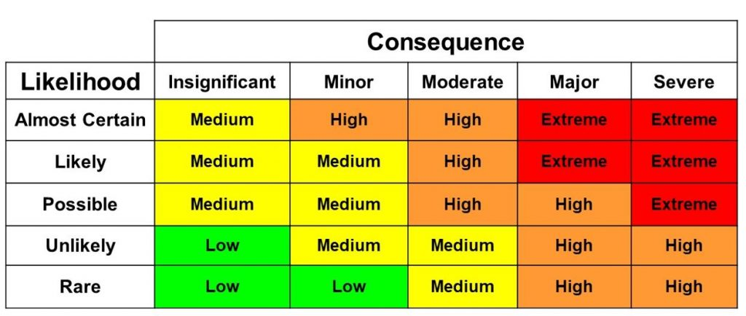
Accessing Risk and Prioritizing Risk
A risk matrix is used during risk assessment to define the level of risk by considering the category of probability or likelihood against the category of consequence severity..

Slide 20
RISK Management Frameworks – Overview
Identify, assess, and prioritize risks.
Implement effective risk mitigation strategies.
Ensure compliance with legal, regulatory, and industry standards.
Enhance decision-making through risk-informed insights.
Protect organizational assets, data, and reputation.

Slide 21
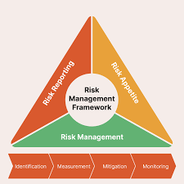
RISK Management Frameworks – Overview
Step 1: Risk Identification
Identify potential risks that could impact the organization.
Categorize risks into relevant domains:
  Strategic Risks – Business decisions, market changes.
  Operational Risks – Process failures, human errors.
  Financial Risks – Budget constraints, fraud.
  Compliance Risks – Legal, regulatory, contractual.
  Technology Risks – Cyber threats, system failures.
  Environmental Risks – Natural disasters, geopolitical issues.

Slide 22
RISK Management Frameworks – Overview
Step 2: Risk Assessment
Evaluate risks based on:
  Likelihood (Probability of occurrence: Low, Medium, High).
  Impact (Effect on business: Low, Medium, High).
  Risk Score = Likelihood × Impact.
Use a Risk Matrix to classify risks as Low, Moderate, High, or Critical.

Slide 23
RISK Management Frameworks – Overview
Step 3: Risk Mitigation & Response
Develop strategies to handle risks:
Avoid – Eliminate activities that generate the risk.
Reduce – Implement controls to lower likelihood/impact.
Transfer – Shift risk via insurance or outsourcing.
Accept – Acknowledge the risk if impact is manageable.

Slide 24
RISK Management Frameworks – Overview
Step 4: Risk Monitoring & Reporting
Continuously monitor risks through Key Risk Indicators (KRIs).
Establish periodic risk assessments (monthly, quarterly, annually).
Document risk management activities in risk registers.
Report risks to senior management and stakeholders.

Slide 25
Importance of Risk Management Frameworks and Primary Components of RMFs
Enhances Decision-Making
Provides a structured approach for evaluating risks before making strategic or operational decisions.
Helps leadership weigh risk against potential rewards.

Slide 26
Importance of Risk Management Frameworks and Primary Components of RMFs
Improves Compliance & Regulatory Adherence
Ensures compliance with industry standards and legal requirements (e.g., ISO 31000, NIST 800-37, COSO ERM, GDPR, PCI-DSS).
Reduces the risk of legal penalties and reputational damage.

Slide 27
Importance of Risk Management Frameworks and Primary Components of RMFs
Protects Organizational Assets & Reputation
Safeguards financial, intellectual, human, and digital assets from threats such as cyberattacks, fraud, or operational failures.
Maintains customer trust by proactively managing risks.

Slide 28
Importance of Risk Management Frameworks and Primary Components of RMFs
Enhances Business Resilience & Continuity
Prepares organizations to handle disruptions (e.g., cyber incidents, natural disasters, financial crises).
Ensures continuity of operations through risk mitigation and contingency planning.

Slide 29
Importance of Risk Management Frameworks and Primary Components of RMFs
Reduces Financial Losses
Identifies financial risks (e.g., fraud, investment risks, budget overruns) and implements controls to minimize monetary impact.
Supports cost-effective risk mitigation strategies.

Slide 30
Importance of Risk Management Frameworks and Primary Components of RMFs
Strengthens Cybersecurity & IT Governance
Essential for protecting data, IT infrastructure, and digital assets against cyber threats.
Helps in implementing security controls (e.g., firewalls, encryption, access controls) aligned with regulatory standards like NIST, ISO 27001, CIS Controls.

Slide 31
Importance of Risk Management Frameworks and Primary Components of RMFs
Fosters a Risk-Aware Culture
Encourages proactive risk identification at all organizational levels.
Empowers employees to make informed decisions about risk exposure in their daily activities.

Slide 32
Importance of Risk Management Frameworks and Primary Components of RMFs
Enables Continuous Monitoring & Improvement
Establishes a risk register and key risk indicators (KRIs) for ongoing monitoring.
Allows organizations to adapt risk strategies based on evolving threats.

Slide 33
Importance of Risk Management Frameworks and Primary Components of RMFs
Supports Strategic Growth & Innovation
Enables businesses to take calculated risks in new ventures (e.g., entering new markets, adopting new technologies).
Ensures that risks associated with growth are identified and managed.

Slide 34
Importance of Risk Management Frameworks and Primary Components of RMFs
Builds Investor & Stakeholder Confidence
Demonstrates to investors, board members, and stakeholders that risks are actively managed.
Enhances credibility and supports sustainable business operations.

Slide 35
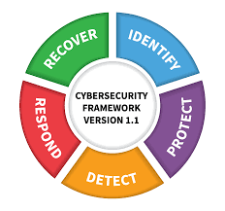
TOP - Risk Management Frameworks
NIST Risk Management Framework (RMF)
Best For: Cybersecurity, IT Governance, Government & Defense Organizations
Developed by the National Institute of Standards and Technology (NIST).
Integrates security, privacy, and cyber risk management into organizational processes.
Follows a 7-step process: Categorize, Select, Implement, Assess, Authorize, Monitor, and Improve.
Used in U.S. federal agencies, defense, and critical infrastructure organizations.
Supports compliance with NIST 800-37, NIST 800-53, and FISMA regulations.
Popular in: Government, military, healthcare, IT, cloud security.

Slide 36
TOP - Risk Management Frameworks
ISO 31000: Risk Management Standard
Best For: Enterprise Risk Management (ERM), General Business Risk Management
Developed by the International Organization for Standardization (ISO).
Provides principles, framework, and processes for managing risks across various sectors.
Focuses on risk identification, analysis, evaluation, treatment, and monitoring.
Adaptable to multiple industries, including finance, healthcare, and manufacturing.
Popular in: Corporate risk management, finance, supply chain, strategic planning.

Slide 37
TOP - Risk Management Frameworks
COSO ERM (Enterprise Risk Management) Framework
Best For: Governance, Financial Risk, Corporate Strategy
Developed by the Committee of Sponsoring Organizations of the Treadway Commission (COSO).
Focuses on governance, risk assessment, control, information, and monitoring.
Helps organizations align risk management with business objectives.
Supports Sarbanes-Oxley Act (SOX) compliance.
Popular in: Public companies, financial institutions, governance, corporate risk strategy

Slide 38
TOP - Risk Management Frameworks
FAIR (Factor Analysis of Information Risk) Framework
Best For: Cyber Risk Quantification, Financial Risk Modeling
A quantitative risk management framework focused on cybersecurity.
Helps organizations financially quantify cybersecurity risks.
Aligns with NIST, ISO 27001, and COSO ERM for cyber risk management.
Popular in: Cybersecurity, insurance, financial risk management.

Slide 39
TOP - Risk Management Frameworks
ISO/IEC 27005 (Information Security Risk Management)
Best For: Information Security, IT Governance
A subset of ISO 27001, focusing specifically on information security risks.
Provides a systematic approach for risk assessment and treatment in IT environments.
Commonly used alongside ISO 27001 to build an Information Security Management System (ISMS).
Popular in: IT security, cybersecurity, compliance, governance.

Slide 40
TOP - Risk Management Frameworks
ISO/IEC 27005 (Information Security Risk Management)
Best For: Information Security, IT Governance
A subset of ISO 27001, focusing specifically on information security risks.
Provides a systematic approach for risk assessment and treatment in IT environments.
Commonly used alongside ISO 27001 to build an Information Security Management System (ISMS).
Popular in: IT security, cybersecurity, compliance, governance.

Slide 41
TOP - Risk Management Frameworks
OCTAVE (Operationally Critical Threat, Asset, and Vulnerability Evaluation)
Best For: IT Risk Assessment, Cybersecurity in Enterprises
Developed by CERT (Carnegie Mellon University).
Focuses on asset-driven security risk assessment.
Helps organizations prioritize critical assets and threats.
Popular in: IT security, enterprises, operational risk management.

Slide 42
TOP - Risk Management Frameworks
COBIT (Control Objectives for Information and Related Technologies)
Best For: IT Risk Management, Governance, Compliance
Developed by ISACA for IT governance and risk management.
Provides guidelines for IT risk assessment, internal controls, and compliance.
Aligns IT with business objectives while managing IT risks.
Popular in: IT governance, regulatory compliance, financial institutions.

Slide 43
TOP - Risk Management Frameworks
Basel Framework (Basel II, III, IV) – Financial Risk Management
Best For: Banking, Financial Institutions, Credit Risk Management
A risk framework developed by the Bank for International Settlements (BIS).
Focuses on credit risk, market risk, and operational risk in financial institutions.
Used by banks and financial institutions to ensure financial stability.
Popular in: Banking, finance, investment firms, risk compliance.

Slide 44
TOP - Risk Management Frameworks
RUST CSF (Common Security Framework)
Best For: Healthcare, Data Security, HIPAA Compliance
Designed for healthcare and other industries handling sensitive data.
Aligns with HIPAA, ISO 27001, NIST, and PCI-DSS to create a unified security approach.
Helps organizations manage compliance and cybersecurity risks.
Popular in: Healthcare, cloud computing, data security.

Slide 45
TOP - Risk Management Frameworks
ITIL (Information Technology Infrastructure Library) Risk Framework
Best For: IT Service Management (ITSM), Business Continuity
A best-practice framework for IT risk management and service delivery.
Helps organizations align IT services with business needs while managing risk.
Often used in ITIL-based IT Service Management (ITSM) systems.
Popular in: IT operations, service management, business continuity planning.

Slide 46
Quick Refresher- WEEK 5 (Day 1)
Risk Management
  Overview of Identifying Risk and Type of Risk
  Risk Identification Techniques
  Accessing Risk and Prioritizing Risk
  Mitigating Risk Monitoring and Communicating in Risk Management
  Risk Management Frameworks – Overview
  Importance of Risk Management Frameworks and Primary Components of RMFs
  Top Risk Management Frameworks Today.
  Benefits of Risk Management Frameworks and Framing your Risks
Introducing Key Legislations and Regulations, Compliance Requirements and Standards

Slide 47
Month 2 - WEEK 5 (Day 2)
Introducing Key Legislations and Regulations, Compliance Requirements and Standards
  Introduction to Key legislations and Regulations (GDPR, HIPAA, NDPA, CCPA, etc)
  Compliance Requirements and Standards
  Examples of Cybersecurity Standards (ISO 27001, PCIDSS, NIST)
Cybersecurity Framework, CSF Core Function and Cybersecurity Legislations
  Cybersecurity Framework
  CSF Core Function
  Cybersecurity Legislation
  Intellectual Property and Copyright Law

Slide 48
Month 2 - WEEK 5 (Day 2)
Ethical Hacking
  Introduction to Ethical Hacking
    Fundamental Security and Hacking Concepts
Privacy and Data Protection Ethics, Cybesecurity Policy Development, Public Awareness and Advocacy

Slide 49
Introducing Key Legislations and Regulations, Compliance Requirements and Standards

Slide 50
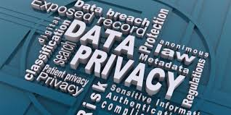
Introduction to key Legislation and Regulations
Importance of Data Protection and Privacy Laws -
  Data protection and privacy laws are essential in today’s digital world, where vast amounts of personal and sensitive information are collected, stored, and processed by organizations. These laws help safeguard individuals' rights, ensure businesses handle data responsibly, and protect against cyber threats and data misuse.

Slide 51
Introduction to key Legislation and Regulations
The growing need for compliance in a digital world -
  In today’s fast-evolving digital landscape, the need for organizations to comply with data protection and privacy regulations has become more critical than ever. The rapid expansion of digital technologies, cloud computing, and global connectivity has resulted in an unprecedented volume of data being created, shared, and stored. This transformation presents significant risks, making regulatory compliance essential to safeguard sensitive information and ensure business continuity.

Slide 52
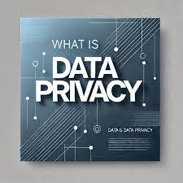
Introduction to key Legislation and Regulations
Understanding Data Privacy & Security Regulation-
  Data protection and privacy laws are legal frameworks designed to regulate how personal and sensitive information is collected, processed, stored, shared, and secured by organizations. These laws aim to protect individuals’ rights to privacy while ensuring that businesses handle data responsibly and securely.

Slide 53
Introduction to key Legislation and Regulations
Data Protection Laws
Data protection laws govern the security and management o personal data to prevent unauthorized access, misuse, or breaches. They establish guidelines for:
How organizations collect and store data
Who can access the data
How data should be transferred and protected
The security measures required to prevent breaches

Slide 54
Introduction to key Legislation and Regulations
Data Privacy Laws
Data privacy laws focus on ensuring that individuals have control over their personal information. These laws define:
The rights of individuals over their data (e.g., access, deletion, rectification)
The obligations of organizations in obtaining consent and being transparent
How data can or cannot be shared with third parties

Slide 55
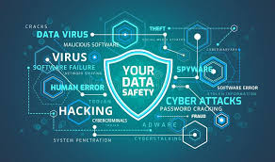
Importance of Data Protection in the Digital Age
Protection of Personal Privacy
Individuals share vast amounts of personal data online (e.g., financial information, health records, browsing history).
Data protection laws ensure that individuals have control over how their data is collected, stored, and used.
Helps prevent identity theft, fraud, and unauthorized surveillance.

Slide 56
Importance of Data Protection in the Digital Age
Compliance with Legal and Regulatory Requirements
Governments worldwide have enacted strict data protection laws (e.g., GDPR, HIPAA, NDPA, CCPA) to protect individuals.
Businesses must comply with these regulations to avoid heavy penalties and legal actions.
Non-compliance can result in financial losses, reputational damage, and even business shutdowns.

Slide 57
Importance of Data Protection in the Digital Age
Preventing Financial Losses
Data breaches can lead to lawsuits, regulatory fines, and loss of business revenue.
Companies must invest in robust security measures to prevent costly incidents.
Ransomware attacks can cripple businesses, demanding hefty payouts

Slide 58
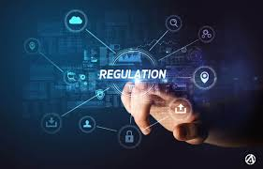
CYBERSECURITY REGULATIONS
Cybersecurity regulations are essential for protecting sensitive information, ensuring compliance, and mitigating cyber threats across industries. These regulations vary by region and industry but share common goals: data security, privacy, and risk management. Below are some of the most critical cybersecurity regulations worldwide:

Slide 59
GLOBAL CYBERSECURITY REGULATIONS
General Data Protection Regulation (GDPR) – EU
Focus: Data privacy and security for EU citizens.
Key Requirements:
  Data protection by design and default.
  Breach notification within 72 hours.
  Heavy fines for non-compliance (up to €20M or 4% of global revenue).

Slide 60
GLOBAL CYBERSECURITY REGULATIONS
ISO/IEC 27001 – International
Focus: Information security management systems (ISMS).
Key Requirements:
  Risk-based approach to cybersecurity.
  Security controls, policies, and audits.
  Certification for organizations demonstrating compliance.

Slide 61
INDUSTRY STANDARD - CYBERSECURITY REGULATIONS
Health Insurance Portability and Accountability Act (HIPAA) – USA
Focus: Protecting patient health information (PHI).
Key Requirements:
  Security, privacy, and breach notification rules.
  Encryption and access controls for PHI.
  Strict penalties for violations.

Slide 62
INDUSTRY STANDARD - CYBERSECURITY REGULATIONS
Payment Card Industry Data Security Standard (PCI-DSS) – Global
Focus: Protecting credit card transactions.
Key Requirements:
  Secure storage of cardholder data.
  Strong encryption and access control.
  Annual compliance validation for merchants and payment processors.

Slide 63
NATIONAL AND REGIONAL STANDARD - CYBERSECURITY REGULATIONS
Cybersecurity Maturity Model Certification (CMMC) – USA
Focus: Defense contractor security (DoD supply chain).
Key Requirements:
  Tiered certification for vendors based on risk level.
  NIST 800-171 compliance for data protection.

Slide 64
NATIONAL AND REGIONAL STANDARD - CYBERSECURITY REGULATIONS
California Consumer Privacy Act (CCPA) – USA
Focus: Consumer data protection for California residents.
Key Requirements:
  Right to access, delete, and opt-out of data sales.
  Transparency in data collection and sharing.

Slide 65
NATIONAL AND REGIONAL STANDARD - CYBERSECURITY REGULATIONS
Nigeria Data Protection Act (NDPA) – Nigeria
Focus: Data protection and privacy compliance for Nigerian businesses.
Key Requirements:
  Consent-based data processing.
  Data subject rights and compliance requirements.

Slide 66
NATIONAL AND REGIONAL STANDARD - CYBERSECURITY REGULATIONS
China Cybersecurity Law (CSL) – China
Focus: Regulating online security and data protection in China.
Key Requirements:
  Data localization for Chinese citizens’ data.
  Strict monitoring of network operations.

Slide 67
Frameworks & Guidelines Supporting Cybersecurity Compliance
NIST Cybersecurity Framework (CSF) – USA
Focus: Best practices for managing cybersecurity risks.
Key Requirements:
  Identify, Protect, Detect, Respond, and Recover framework.

Slide 68
Frameworks & Guidelines Supporting Cybersecurity Compliance
CIS Controls – Global
Focus: Cyber defense strategies for businesses.
Key Requirements:
  18 security controls for preventing cyberattacks.

Slide 69
Frameworks & Guidelines Supporting Cybersecurity Compliance
SOC 2 – Global (AICPA)
Focus: Security, availability, processing integrity, confidentiality, and privacy.
Key Requirements:
  Audits for service providers handling sensitive data.

Slide 70
Cybersecurity REGULATIONS
Cybersecurity regulations play a crucial role in protecting personal, financial, and organizational data from cyber threats. Compliance helps businesses avoid hefty fines, data breaches, and reputational damage. Organizations should align their security strategies with these regulations to ensure data integrity, confidentiality, and availability.

Slide 71
Cybersecurity Framework, CSF Core Function and Cybersecurity Legislations

Slide 72
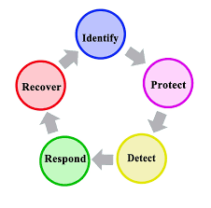
Cybersecurity Framework (CSF)
A Cybersecurity Framework is a set of guidelines, best practices, and standards designed to help organizations manage cybersecurity risks effectively. It provides a structured approach to securing information systems, protecting sensitive data, and ensuring compliance with security regulations.

Slide 73
Cybersecurity Framework (CSF)
Key Objectives of a Cybersecurity Framework:
Establish a risk-based approach to cybersecurity.
Standardize security processes across industries.
Improve the ability to detect, respond to, and recover from cyber incidents.
Ensure compliance with legal and regulatory requirements.

Slide 74
POPOLAR Cybersecurity Framework (CSF)
NIST Cybersecurity Framework (CSF) – U.S. government standard for cybersecurity risk management.
ISO/IEC 27001 – International standard for information security management.
CIS Controls – A set of best practices to protect organizations from cyber threats.
COBIT (Control Objectives for Information and Related Technologies) – IT governance framework for managing risk.
2 (System and Organization Controls 2) – Security compliance framework for service providers.

Slide 75
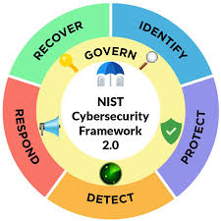
NIST CSF Core Functions
The NIST Cybersecurity Framework (CSF), developed by the U.S. National Institute of Standards and Technology (NIST), provides a flexible and comprehensive approach to managing cybersecurity risks. The framework consists of five core functions, which act as the foundation for a successful cybersecurity strategy:

Slide 76
NIST CSF Core Functions
Identify
Understand and manage cybersecurity risks to systems, assets, data, and capabilities.
Key activities:
  Asset management
  Risk assessment
  Governance and compliance

Slide 77
NIST CSF Core Functions
Protect
Implement safeguards to ensure the security of systems and sensitive information.
Key activities:
  Access control
  Data security and encryption
  Security awareness training
  Protective technology implementation

Slide 78
NIST CSF Core Functions
Detect
Establish mechanisms to identify cybersecurity events and threats in real time.
Key activities:
  Continuous monitoring
  Threat detection and analysis
  Security event logging

Slide 79
NIST CSF Core Functions
Respond
Develop and implement incident response plans to contain and mitigate cybersecurity incidents.
Key activities:
  Incident response planning
  Communication and reporting
  Forensic analysis
  Mitigation and recovery actions

Slide 80
NIST CSF Core Functions
Recover
Restore systems, services, and operations after a cybersecurity event.
Key activities:
  Business continuity planning
  Disaster recovery
  Post-incident review and improvement

Slide 81
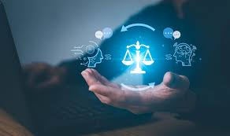
CYBERSECURITY LEGISLATION
Cybersecurity legislations are laws and regulations designed to govern data security, privacy, and risk management across different industries and regions. These laws ensure that organizations implement appropriate security measures and comply with legal obligations to protect sensitive information.

Slide 82
CYBERSECURITY LEGISLATION
Cybersecurity legislations are laws and regulations designed to govern data security, privacy, and risk management across different industries and regions. These laws ensure that organizations implement appropriate security measures and comply with legal obligations to protect sensitive information.

Slide 83
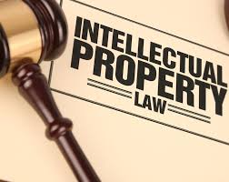
Understanding Intellectual Property (IP)
Intellectual Property (IP) refers to intangible creations of the mind, such as inventions, artistic works, brand names, trade secrets, and proprietary technology. IP laws grant legal protection to these creations, ensuring that their owners can benefit from their use and prevent unauthorized exploitation.

Slide 84
Types of Intellectual Property
Copyright: Protects literary, artistic, and creative works such as books, music, films, and software.
Patents: Grants exclusive rights to inventors for new inventions, preventing others from making, using, or selling them without permission.
Trademarks: Protects brand names, logos, slogans, and distinctive signs used in commerce.
Trade Secrets: Covers confidential business information, formulas, processes, or practices that give a company a competitive edge.
Industrial Designs: Protects the aesthetic or ornamental aspects of a product, such as its shape, color, or pattern.

Slide 85
INTRODUCTION TO ETHICAL HACKING

Slide 86
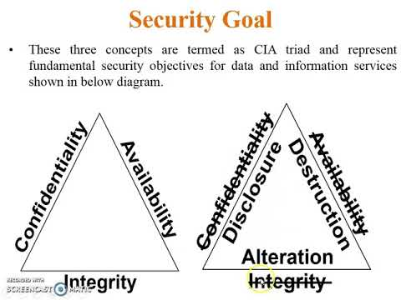
Fundamental security concepts
In addition to the CIA triad, other properties, such as authenticity, accountability, non-repudiation and reliability can also be involved.
Authenticity Refers to the characteristic of a communication, document, or any data that ensures the quality of being genuine
Auditing & Accountability Basically keep tracking of every thing, like, who's been logging in when are they login in whose access this data.
Non-Repudiation Non-repudiation is the assurance that someone cannot deny the validity of something. Non-repudiation is a legal concept that is widely used in information security and refers to a service, which provides proof of the origin of data and the integrity of the data.

Slide 87
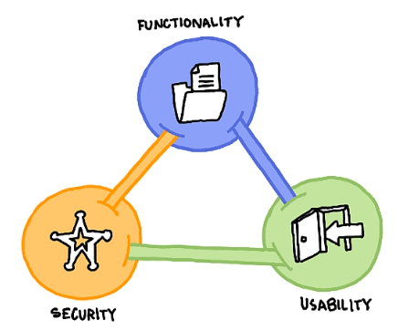
Security, Functionality and Usability balance
There is an inter dependency between these three attributes. When security goes up, usability and functionality come down. Any organization should balance between these three qualities to arrive at a balanced information system

Slide 88
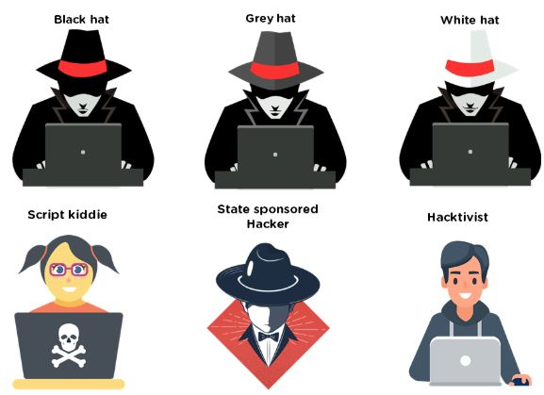
Types of Hackers
Refresher…
Black Hat - Hackers that seek to perform malicious activities.
Gray Hat - Hackers that perform good or bad activities but do not have the permission of the organization they are hacking against.
White Hat - Ethical hackers; They use their skills to improve security by exposing vulnerabilities before malicious hackers.

Slide 89
Types of ATTACKERs
Let’s talk about others attackers.
Script Kiddie / Skiddies - Unskilled individual who uses malicious scripts or programs, such as a web shell, developed by others to attack computer systems and networks and deface websites.
State-Sponsored Hacker - Hacker that is hired by a government or entity related.
Hacktivist - Someone who hacks for a cause; political agenda.
Suicide Hackers - Are hackers that are not afraid of going jail or facing any sort of punishment; hack to get the job done.
Cyberterrorist - Motivated by religious or political beliefs to create fear or disruption.

Slide 90
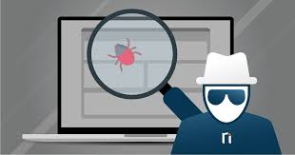
HACKING VOCABULARY
Hack value - Perceived value or worth of a target as seen by the attacker.
Vulnerability - A system flaw, weakness on the system (on design, implementation etc).
Threat - Exploits a vulnerability.
Exploit - Exploits are a way of gaining access to a system through a security flaw and taking advantage of the flaw for their benefit.
Payload - Component of an attack; is the part of the private user text which could also contain malware such as worms or viruses which performs the malicious action; deleting data, sending spam or encrypting data.
Zero-day attack - Attack that occurs before a vendor knows or is able to patch a flaw.
Daisy Chaining / Pivotting - It involves gaining access to a network and /or computer and then using the same information to gain access to multiple networks and computers that contains desirable information.
Doxxing - Publishing PII about an individual usually with a malicious intent.
Enterprise Information Security Architecture (EISA) - determines the structure and behavior of organization's information systems through processes, requirements, principles and models.

Slide 91
Threat Categories
Network Threats | Host Threats | Application Threats
Information gathering Sniffing and eavesdropping DNS/ARP Poisoning MITM (Man-in-the-Middle Attack) DoS/DDoS Password-based attacks Firewall and IDS attack Session Hijacking | Password cracking Malware attacks Footprinting Profiling Arbitrary code execution Backdoor access Privilege Escalation Code Execution | Injection Attacks Improper data/input validation Improper error handling and exeception management Hidden-field manipulation Broken session management Cryptography issues SQL injection Phishing Buffer Overflow Information disclosure Security Misconfigurations

Slide 92
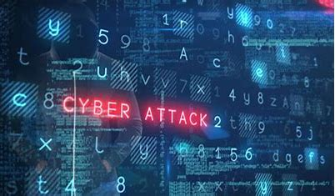
Some Attack Vectors
Path by which a hacker can gain access to a host in order to deliver a payload or malicious outcome
APT - Advanced Persistent Threats
  An advanced persistent threat is a stealthy threat actor, typically a nation state or state-sponsored group, which gains unauthorized access to a computer network and remains undetected for an extended period; Typically uses zero-day attacks.
Cloud computing / Cloud based technologies
  Flaw in one client's application cloud allow attacker to access other client's data
Ransomware
  Restricts access to the computer system's files and folders and demands an online ransom payment to the attacker in order to remove the restrictions.
Web Application Threats
  Attacks like SQL injection, XSS (Cross-site scripting)...

Slide 93
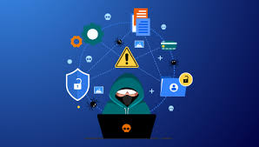
Vulnerability Categories
Misconfiguration - improperly configuring a service or application
Default installation - failure to change settings in an application that come by default
Buffer overflow - code execution flaw
Missing patches - systems that have not been patched
Design flaws - flaws inherent to system design such as encryption and data validation
Operating System Flaws - flaws specific to each OS
Default passwords - leaving default passwords that come with system/application

Slide 94
Pen Test Phases
Pre-Attack Phase - Reconnaissance and data-gathering.
Attack Phase - Attempts to penetrate the network and execute attacks.
Post-Attack Phase - Cleanup to return a system to the pre-attack condition and deliver reports.

Slide 95

STAGES IN ETHICAL HACKING
Reconnaissance
Gathering evidence about targets; There are two types of Recon:
  Passive Reconnaissance: Gain information about targeted computers and networks without direct interaction with the systems. e.g: Google Search, Public records, New releases, Social Media, Wardrive scanning networks around.
  Active Reconnaissance: Envolves direct interaction with the target. e.g: Make a phone call to the target, Job interview; tools like Nmap, Nessus, OpenVAS, Nikto and Metasploit can be considered as Active Recon.

Slide 96
STAGES IN ETHICAL HACKING
Scanning & Enumeration
Obtaining more in-depth information about targets. e.g: Network Scanning, Port Scanning, Which versions of services are running.

Slide 97
STAGES IN ETHICAL HACKING
Gaining Access
Attacks are leveled in order to gain access to a system
  e.g: Can be done locally (offline), over a LAN or over the internet.
  e.g(2): Spoofing to exploit the system by pretending to be a legitimate user or different systems, they can send a data packet containing a bug to the target system in order to exploit a vulnerability. Can be done using many techniques like command injection, buffer overflow, DoS, brute forcing credentials, social engineering, misconfigurations etc.

Slide 98
STAGES IN ETHICAL HACKING
Gaining Access
Maintaining Access - Items put in place to ensure future access. e.g: Rookit, Trojan, Backdoor can be used.

Slide 99
STAGES IN ETHICAL HACKING
Covering Tracks
Steps taken to conceal success and intrusion; Not be noticed.
  e.g: Clear the logs; Obfuscate trojans or malicious backdoors programs.

Slide 100
Privacy and Data Protection Ethics

Slide 101
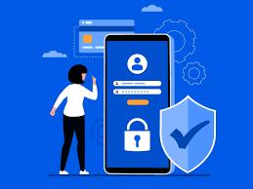
Privacy and Data Protection Ethics
Vast amounts of personal and sensitive data are collected, processed, and shared by organizations. Privacy and Data Protection Ethics focus on ensuring that individuals' data is handled responsibly, transparently, and securely. Ethical data practices go beyond legal compliance, fostering trust between organizations and individuals while preventing misuse or exploitation of personal information.
Ethical privacy and data protection principles emphasize fairness, transparency, accountability, and respect for individual rights. Organizations must balance their need to collect data with individuals' rights to privacy and autonomy.

Slide 102
Understanding Privacy and Data Protection Ethics
Key ethical considerations include:
  Respect for Individual Autonomy – People should have control over their personal data and the right to decide how it is used.
  Transparency and Honesty – Organizations must clearly inform users about what data is collected, how it is used, and with whom it is shared.
  Fair and Lawful Data Processing – Data should be collected and processed for legitimate, ethical, and legal purposes.
  Data Minimization – Only necessary data should be collected and retained for the minimum required duration.
  Security and Confidentiality – Organizations must implement strong cybersecurity measures to protect personal data from breaches and unauthorized access..

Slide 103
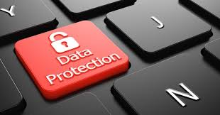
Ethical Principles in Privacy and Data Protection
A. Informed Consent - Individuals must be given clear, understandable choices about data collection. They should be able to opt in or out without coercion. Example: Websites should not use pre-checked consent boxes that force users to share data.
B. Right to Access and Control - People should be able to access their personal data, correct inaccuracies, or request its deletion. Example: GDPR’s Right to Be Forgotten allows individuals to request the removal of their data from online platforms.

Slide 104
Ethical Principles in Privacy and Data Protection
C. Accountability and Responsibility - Organizations must take responsibility for ethical data handling and be prepared to justify their data practices. Example: Companies should conduct Data Protection Impact Assessments (DPIAs) before launching new data-driven services.
D. Fairness and Non-Discrimination - AI-driven systems and data analytics should not be used to unfairly discriminate against individuals based on race, gender, or other sensitive attributes. Example: Hiring algorithms should be audited to ensure they do not unfairly reject job applicants based on biased training data.

Slide 105
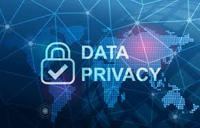
Ethical Challenges in Privacy and Data Protection
Surveillance and Tracking
Ethical dilemma: Governments and businesses use data tracking technologies for security and marketing, but this can invade personal privacy.
  Solution: Organizations should implement privacy-by-design strategies and limit data collection to what is essential.
AI and Data Ethics
Ethical dilemma: AI systems process massive amounts of personal data, raising concerns about bias, fairness, and informed consent.
  Solution: AI developers should apply fairness and transparency principles in training models and avoid excessive data retention.

Slide 106
Ethical Challenges in Privacy and Data Protection
Cybersecurity and Data Breaches
Ethical dilemma: Organizations collecting vast data are responsible for securing it against hackers, but many fail to prioritize security.
  Solution: Strong encryption, regular security audits, and zero-trust security models should be implemented.

Slide 107
Cybersecurity Policy Development

Slide 108
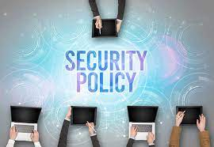
CYBERSECURITY POLICY
A Cybersecurity Policy is a structured set of guidelines that define how an organization protects its information systems, networks, and data from cyber threats. It provides employees, partners, and stakeholders with clear rules and procedures to ensure the confidentiality, integrity, and availability of information assets.
Developing a comprehensive cybersecurity policy is essential to protect against data breaches, cyberattacks, and compliance violations.

Slide 109
Importance of Cybersecurity Policy
A well-defined cybersecurity policy:
  Sets clear security expectations for employees and third parties.
  Mitigates risks by defining preventive and response measures.
  Ensures regulatory compliance with laws like GDPR, NDPA, HIPAA, and ISO 27001.
  Enhances incident response readiness by outlining breach handling procedures.
  Builds cybersecurity culture within an organization.

Slide 110
Key Components of a Cybersecurity Policy
Purpose and Scope
Defines the objectives of the policy.
Specifies which departments, employees, and systems it applies to.
Identifies legal and regulatory frameworks governing security.
  .

Slide 111
Key Components of a Cybersecurity Policy
Roles and Responsibilities
Assigns cybersecurity duties to different teams, such as:
IT Security Team – Responsible for monitoring threats and implementing controls.
Employees – Must follow security best practices (e.g., strong passwords, phishing awareness).
Management – Ensures compliance and resource allocation.
  .

Slide 112
Key Components of a Cybersecurity Policy
Compliance and Legal Considerations
Aligns with global and local cybersecurity laws (GDPR, NDPA, ISO 27001, CCPA).
Specifies penalties for violating security policies.

Slide 113
Key Components of a Cybersecurity Policy
Security Awareness and Training
Employees must undergo regular cybersecurity training.
Conduct phishing simulation tests to improve awareness.

Slide 114
Types of a Cybersecurity Policy
Access Control and Authentication
Defines who can access what data and under what conditions.
Enforces Multi-Factor Authentication (MFA) for sensitive systems.
Implements role-based access control (RBAC) to limit unnecessary access.
  .

Slide 115
Types of a Cybersecurity Policy
Data Protection and Encryption
Requires encryption of sensitive data (e.g., AES-256, TLS).
Specifies data retention and disposal policies.
Implements backup procedures to prevent data loss.
  .

Slide 116
Types of a Cybersecurity Policy
Network and Endpoint Security
Mandates use of firewalls, intrusion detection systems (IDS), and VPNs.
Ensures patch management for operating systems and applications.
Establishes guidelines for securing remote work and BYOD (Bring Your Own Device) policies.
  .

Slide 117
Types of a Cybersecurity Policy
Incident Response and Reporting
Defines steps for detecting, responding, and recovering from cyber incidents.
Requires employees to report suspicious activities immediately.
Includes business continuity and disaster recovery (BCDR) plans.

Slide 118
Types of a Cybersecurity Policy
Acceptable Use Policy (AUP)
Defines what employees can and cannot do with corporate systems and data.
Covers rules for social media, personal device usage, and email security.

Slide 119
Cybersecurity Policy Development Process
Assess Risks and Requirements
Define Policy Objectives
Draft the Policy
Review and Approve
Implement and Train Employees
Monitor and Update

Slide 120
Roles of Professional Organizations in Cybersecurity

Slide 121
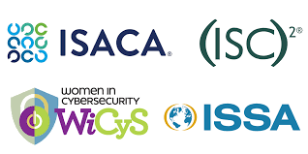
ROLES OF PROFESSIONAL BODIES
Professional organizations like SANS Institute (SANS), Information Systems Audit and Control Association (ISACA), and International Information System Security Certification Consortium (ISC²) play a critical role in shaping cybersecurity standards, advancing industry knowledge, and supporting professionals through certifications, training, and best practices.

Slide 122
ISACA
Information Systems Audit and Control Association (ISACA), is a globally recognized professional organization that focuses on IT governance, risk management, cybersecurity, and auditing. It supports professionals in managing and securing information systems through certifications, frameworks, and networking opportunities.

Slide 123
KEY ROLES
IT Governance and Risk Management – Develops frameworks like COBIT (Control Objectives for Information and Related Technologies) for IT governance.
Cybersecurity and Audit Standards – Establishes security and compliance standards for IT audit, cybersecurity, and risk assessment.
Certifications and Career Development – Offers industry-leading credentials to validate expertise in information security, risk management, and governance.
Research and Publications – Publishes reports on emerging cyber threats, IT governance trends, and audit best practices.
Conferences and Workshops – Organizes global events like ISACA Cybersecurity Nexus (CSX) for professional networking and skill development.

